Slide 1
FsLab Doing data science with F#
Tomas Petricek
tomas@tomasp.net | @tomaspetricek
PhD Student at Cambridge & Coordinator of http://fsharp.org

Slide 2
software stacks trainings teaching F# user groups snippets mac and linux community books and tutorials
F# Software Foundation
consulting open-source MonoDevelop
http://www.fsharp.org
contributions research support cross-platform mailing lists

Slide 3
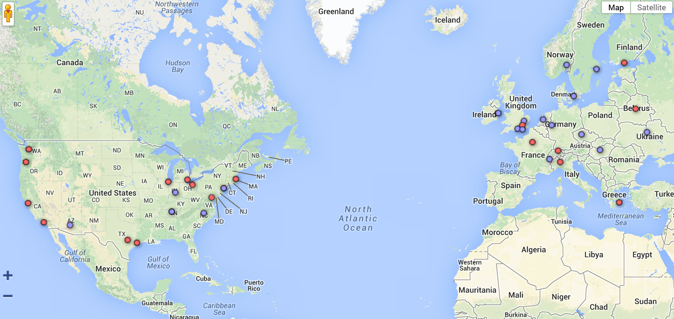
Community matters!

Slide 4
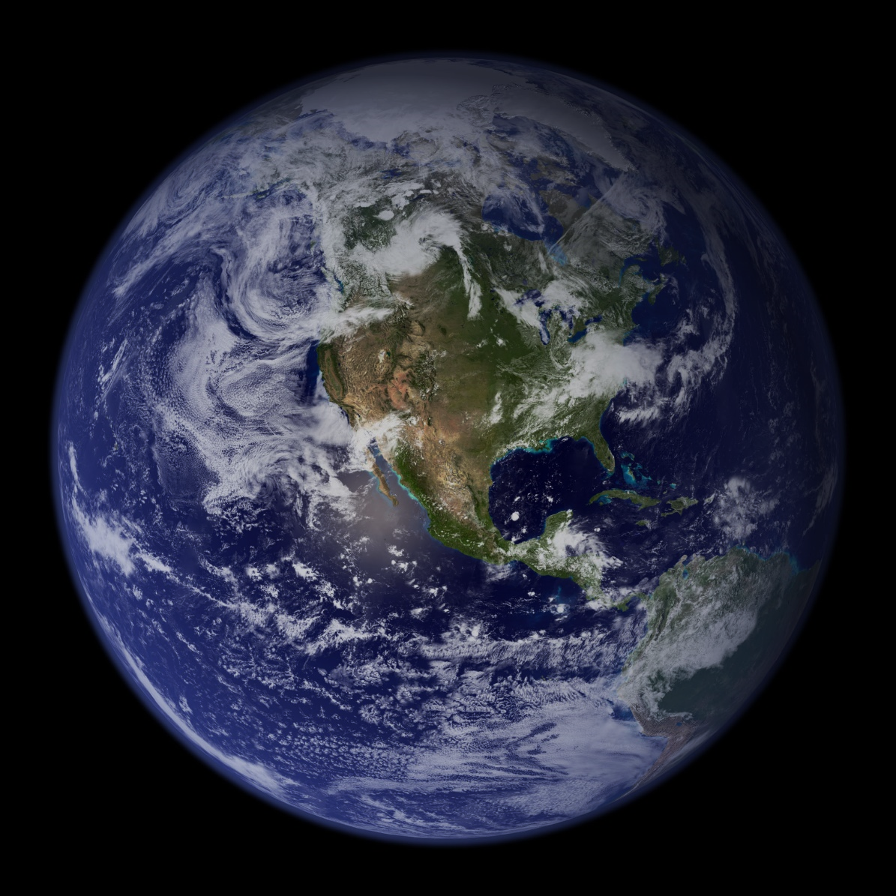
All the Data of the World

Slide 5
Acquire
Analyze
Visualize

Slide 6
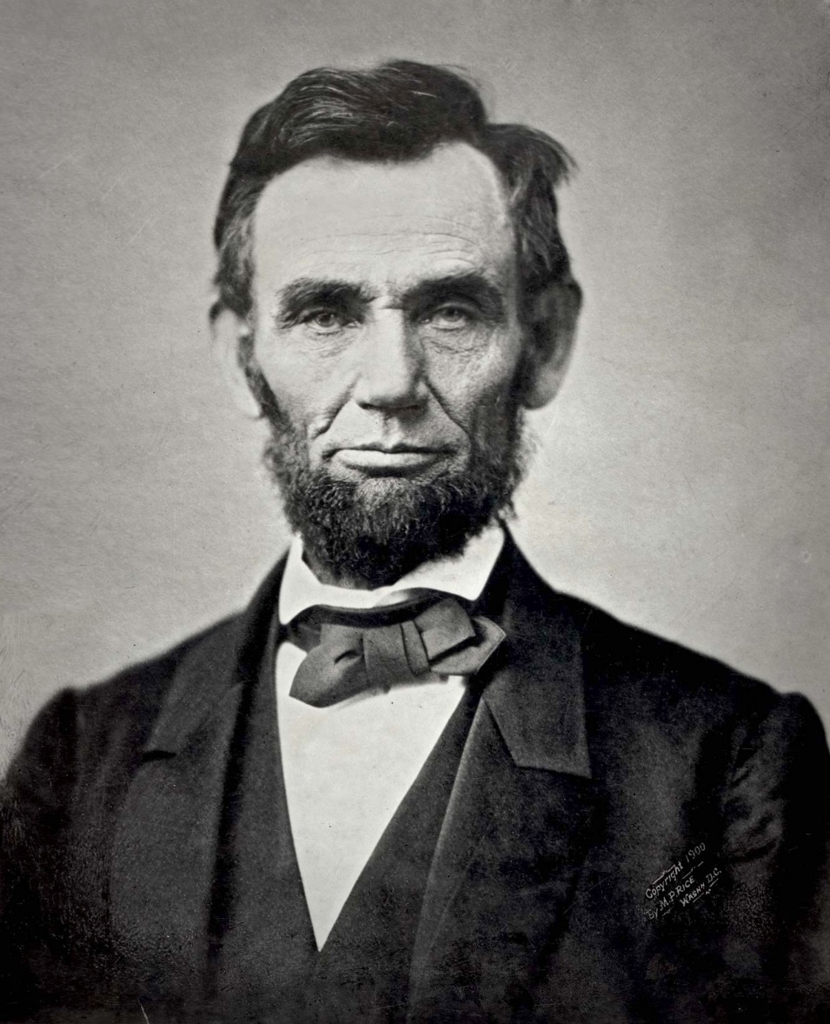
Demo: US debt over the last century

Slide 7
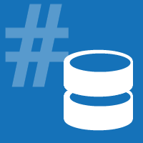

F# Data type providers
First-class data
XML, JSON, WorldBank…
Deedle data frame
Time-series alignment
Data transformations
www.fslab.org

Slide 8
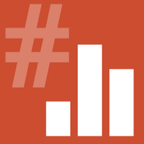

F# Charting
Interactive charting
Simple & composable
FsLab package
Integration package
Easy to get & use!
www.fslab.org

Slide 9
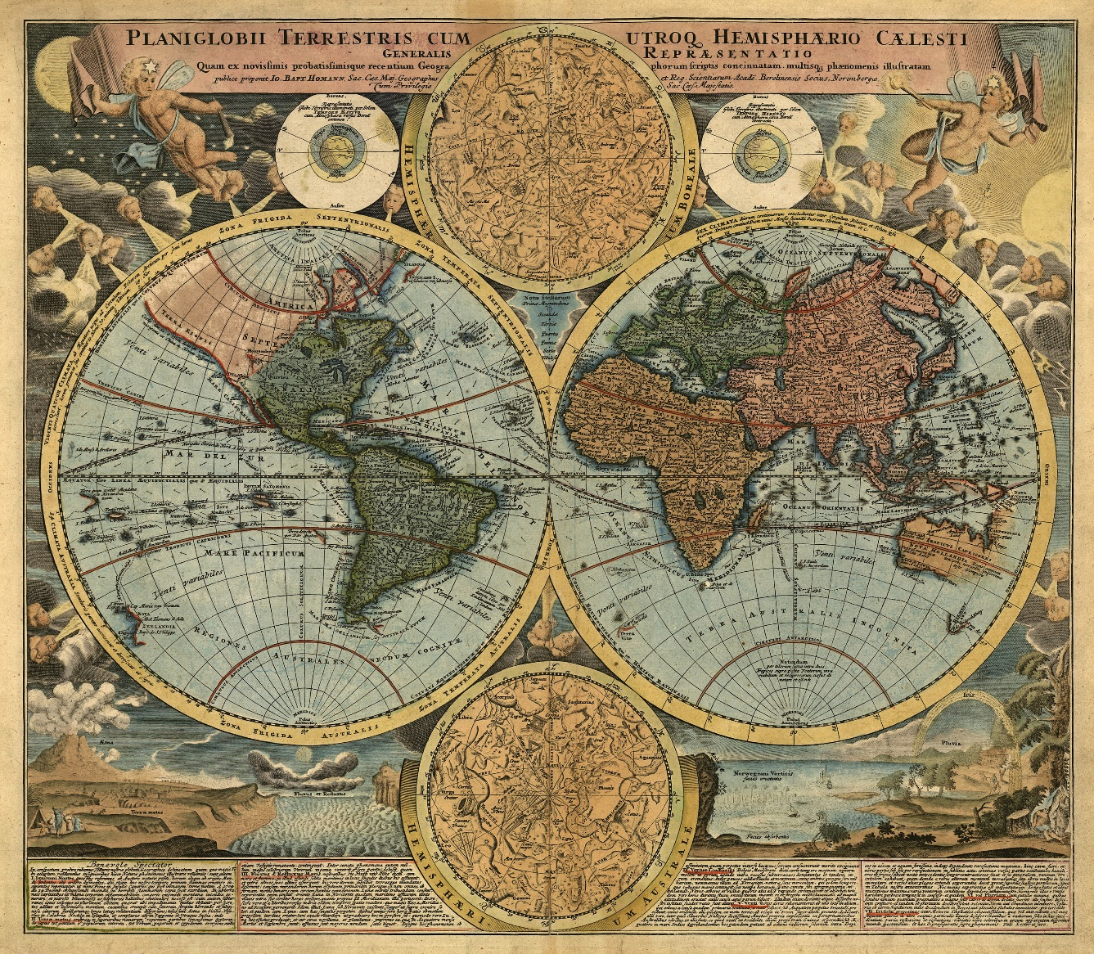
Demo: Understanding the world

Slide 10

Deedle data frame
Integration point
Charts, machine learning
Foogle Charts
Google Charts wrapper
Work in progress!
www.fslab.org

Slide 11

R Type provider
Statistics & visualization
5000 tested packages
FsLab Journal
Literate programming
HTML & PDF reports
www.fslab.org

Slide 12
F# for Data Science
acquire, analyze, visualize
interactive experience
safety and efficiency of .net
ready for production
tomas@tomasp.net | @tomaspetricek

Slide 13
How are we doing this?
open-source from the start
great community tools
permissive license
inclusive & collaborative
tomas@tomasp.net | @tomaspetricek

Slide 14
Research questions
understanding live coding
make it more type-safe
data journalism
everyone should code
tomas@tomasp.net | @tomaspetricek

Slide 15
Going forward
Use F# for data science!
Come to F# user groups
Help us build data science tools!
fsharp.org | fslab.org | tomasp.net
tomas@tomasp.net & @tomaspetricek

Slide 16
data acquisition statistics data cleaning machine learning data transformation visualization type providers
F# Data Science Working Group
kaggle grammar of graphics data sources presentation
R provider visualization
www.fslab.org
time-series data aggregation

